Slide 1
TARGET Storage
OBJECTIVE HECTOR
Killbox DP

Slide 2
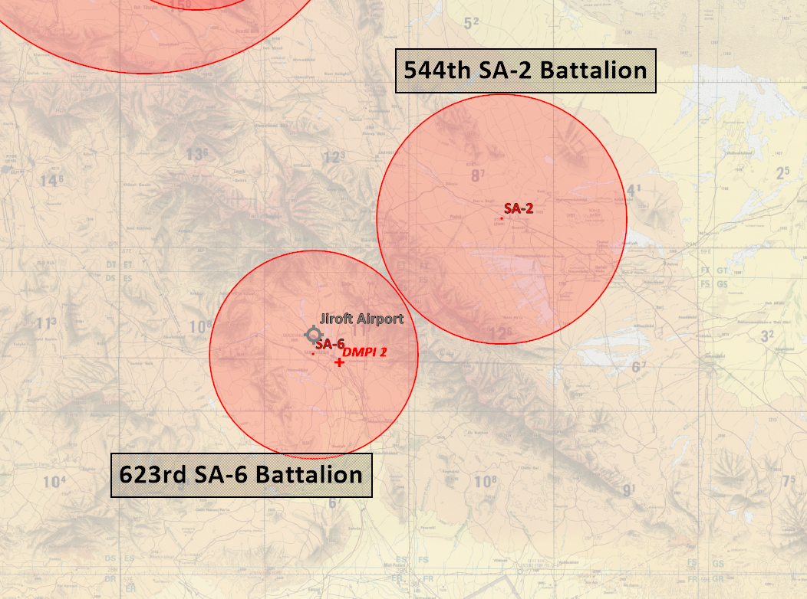
OBJECTIVE HECTOR

Slide 3
DPI 1: N28 38.994 E057 45.094, alt: 2169ft
DPI 2: N28 39.006 E057 45.106, alt 2169ft
Target are 2 storage buildings assessed to contain
pre-cursors for chemical weapons and are a time
sensitive target that need to be neutralized before it
is moved to a location where it is assembled into a
chemical weapon.

Slide 4
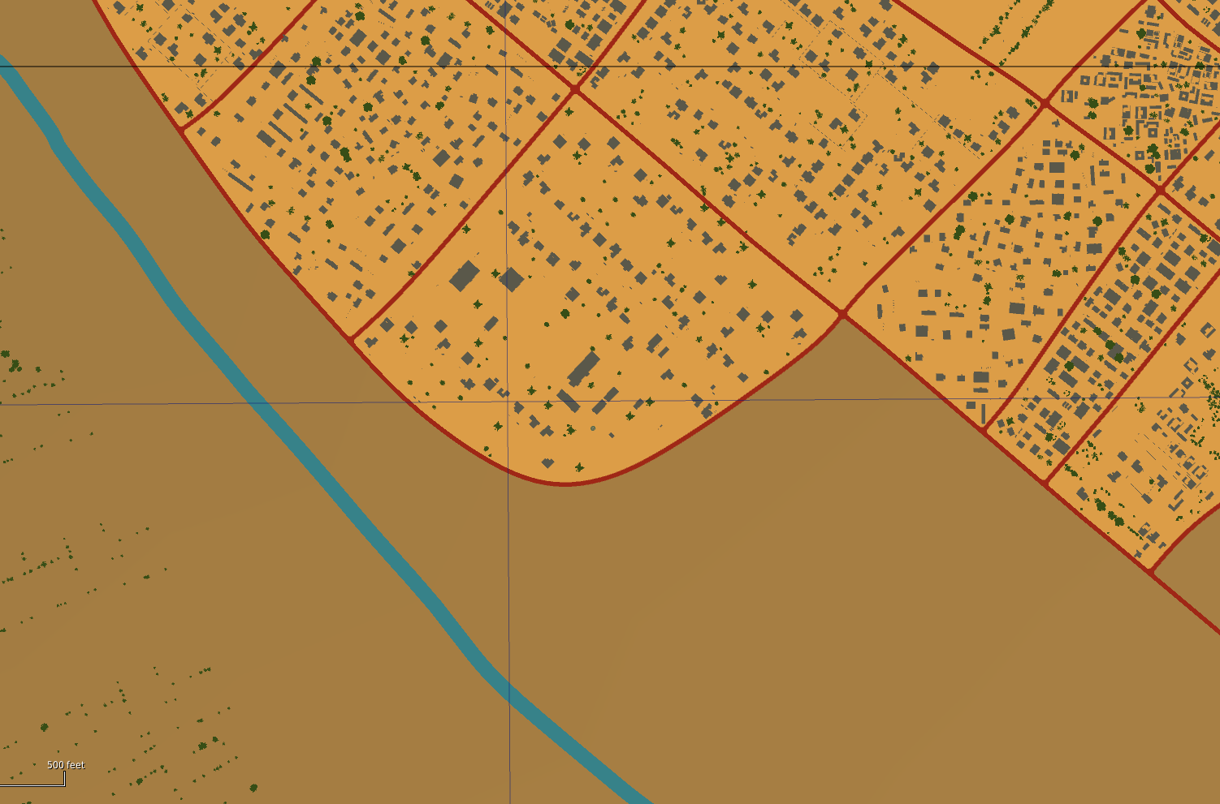
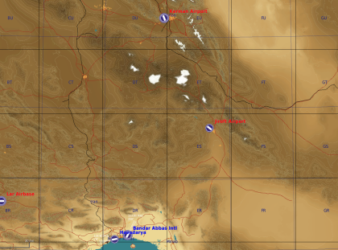
DPI 2
DPI 1

Slide 5
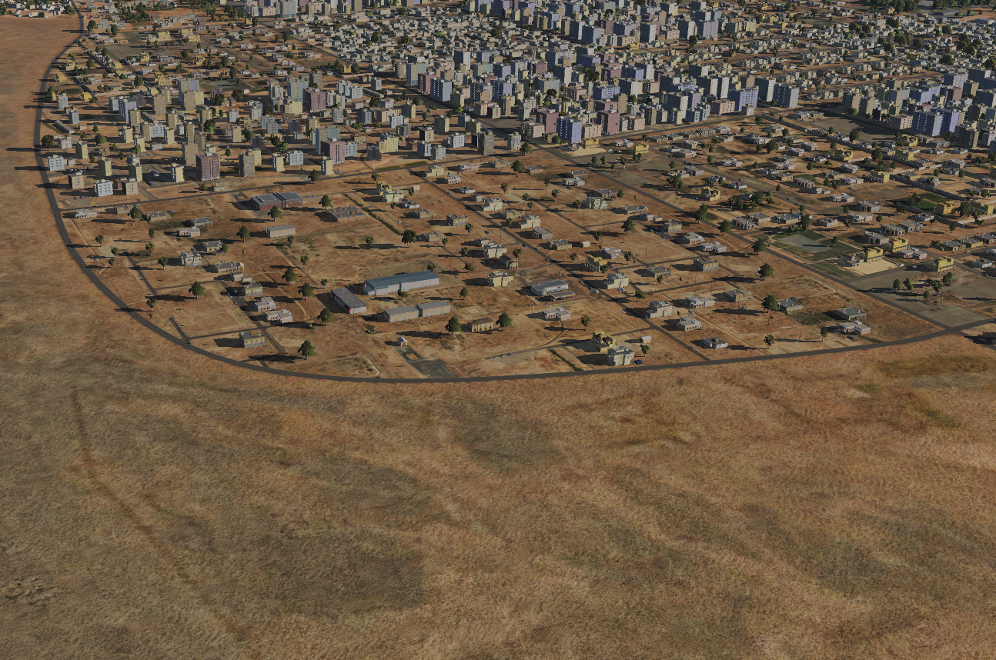
N
SA-6 threat
DPI 2
DPI 1

Slide 6
N
IP
DPI 2
DPI 1

Slide 7
N

